Slide 1

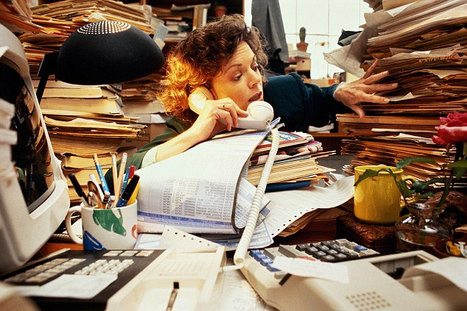
Time Tracking solutions
Got a Sec?
Why didn’t you write that down?
Notes:
How many are salaried employees?
How many need to track their time despite not being hourly employees?
Yeah, me too.

Slide 2
Management feeds on numbers
They use these numbers to justify headcount
YOU are one of those headcounts
Can you explain to management how you spent your time today?
Notes:
Not all bosses micromanage. Your mileage may vary.

Slide 3
Promotions and layoffs associated with productivity
Notes:
Graphs are often very impressive

Slide 4
Compare and contrast these employees
First group has GotASec working for them
Second group does not
This is what management sees
 | Group 1 | Group 2
Busy | Yes | yes
Numbers to back this up | Yes | No
Indispensable? | Yes | No
Notes:
Tables can also be impressive

Slide 5
Introducing Gotasec
A very comfortable collar

Slide 6
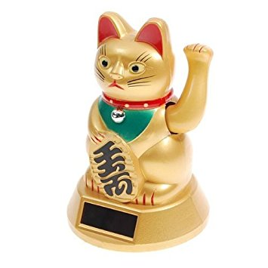
Monitor walk-ups and random questions
Just put the gotasec on your desk
And GotaSec will track walkup times
for you
Example report:
May 1 2017 09:05 60 minutes
May 1 2017 11:30 30 minutes
May 1 2017 13:00 45 minutes
May 1 2017 14:00 20 minutes
May 1 2017 16:45 90 minutes
Notes:
Your walkups can now be tracked w/o user intervention!

Slide 7
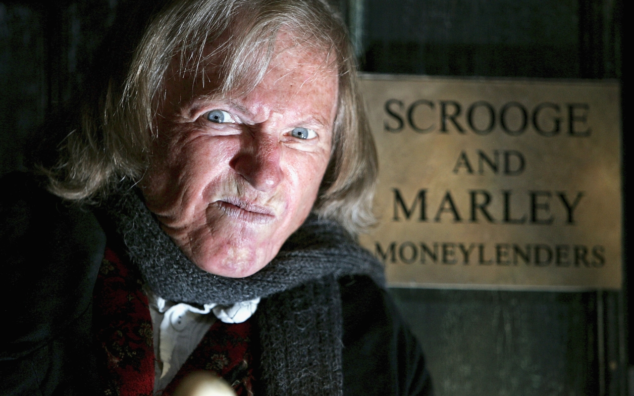
Your boss will be impressed (slightly)

Slide 8
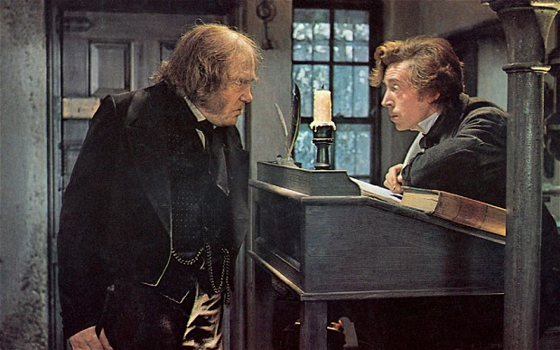
You won’t get fired (yet)

Slide 9
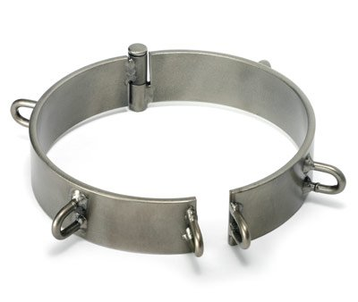
Management version coming soon
Notes:
Get the enchanted object soon, or mgmt. will develop their own version to deploy.

Slide 10
GotASec components
Connect to BLE
Sync time
Monitor for visitors
Send message via BLE when visitor leaves
Accept data via BLE
Publish data via mqtt to the Cloud
Subscribe mqtt topic
Generate report
iPhone App Bluefruit
Receive Publish
store same
Mqtt client
Arduino Uno
io.particle.com

Slide 11
Time to Nerd out!
Code highlights
Includes AdaFruit libraries, Time, and Timezone
Asks for ctime at startup (seconds since epoch) to set the “clock”
Time code shamelessly stolen from their github page, ditto BlueFruit code
Timezone required otherwise timestamps are 6 hours off
Uses iPhone app ‘bluefruit’ to receive data then publish via mqtt to io.adafruit.com
Uses a photovoltaic sensor to “see” people and a blue LED lights when they are present
These will be the “eyes” of the Lucky Cat in version 2.0

Slide 12
Time to Nerd out!
Code snippets
Serial.println("Please enter ctime in form T123467890");
// wait long enough for dumb human to enter time then process same.
delay(10000);
processSyncMessage();
<snip!>
// A double factory reset for the Bluetooth cuz once ain’t never enough!
if ( ! ble.factoryReset() ) {
// try twice before giving up
if ( ! ble.factoryReset() ) {
error(F("Couldn't factory reset")); } }

Slide 13
Time to Nerd out!
Code snippets
// we want to output a 1 if "someone is there" and a 0 if "no one is there" val = check_it();
delay(1000);
if ( val == 0 && val == check_it()) {
//cha-ching, they're still there
<snip!>
startTime = now();
startTime = usCentral.toLocal(startTime);
// wait for them to go away
while ( check_it() == 0) {
delay(1000); } // went dark, they left.

Slide 14
Time to Nerd out!
Code snippets
endTime = now();
endTime = usCentral.toLocal(endTime);
duration = endTime - startTime;
output = String(month(startTime)) + "/" + String(day(startTime)) + "/" + \ String(year(startTime)) + " " + String(hour(startTime)) + ":" + \ String(minute(startTime)) + " : " + String(duration) + "\n";
<snip!>
delay(3000);
ble.print(output);
delay(3000);

